Slide 1
CHARACTERIZING & REPRESENTING NEW YORK CITY’S TAXI TRANSPORTATION NETWORK
^{Nilesh Patil Jiang Shang}
Dec 12 2016

Slide 2
Introduction
Project Goal:
Determining travel patterns of NYC residents from 146+ million taxi trips
Peculiarities in the transportation network : critical points, restrictions etc
Core assumptions:
Given the large number of rides being used, a generalization of travel pattern is plausible
General locality of nodes is representative of travel type
Notes:
Jiang

Slide 3
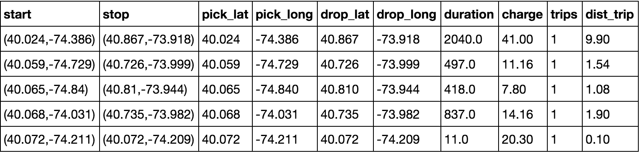
Data Description
Raw Data
New York city taxi & Limousine Commission
Taxi rides 2015
Census tracts : US Census Bureau, 2010 census
146 million trips:
Coordinates for pickup, drop & timestamp as trip identifier
Cost, Duration & distance as information associated with the ride

Slide 4
Graph generation
Data Munging
Directed Graph
Cleaning :
Restrict the trips to NYC boroughs
Remove trips starting and ending at the same position
Remove trips with zero duration
Aggregation:
Combine the dataset with census tracts
Aggregate trips by month, day, hour etc
Sum trips, duration, cost
Use average value for analysis
Tools :
Spark for initial data aggregation & reshaping
Python, Igraph, networkx for analysis
Generate directed graph from 2015 aggregated values:
Represent one location by its geo co-ordinates
Treat each location as node
Total trips between two nodes are represented as corresponding edge weight
Original locations with 200m diameter give about 50k+ nodes, higher resolution but difficult to analyze
Census tracts correspond to about 580 nodes

Slide 5
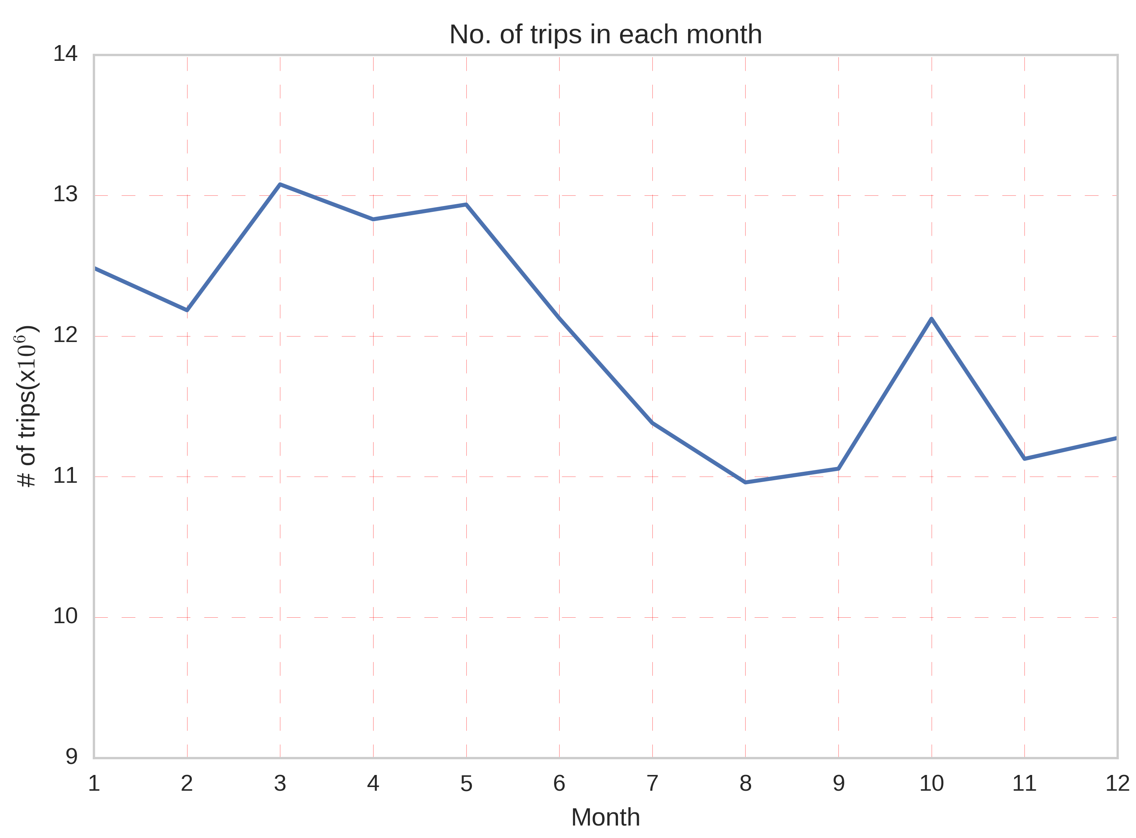
Exploratory analysis - 01
Month-wise trip distribution
Trips taken in each month peaks between March-May and drops substantially during June onwards
This can be attributed directly to weather pattern, as commuters are expected to avoid walking long distances during low temperatures or rainy weather
Notes:
Jiang

Slide 6
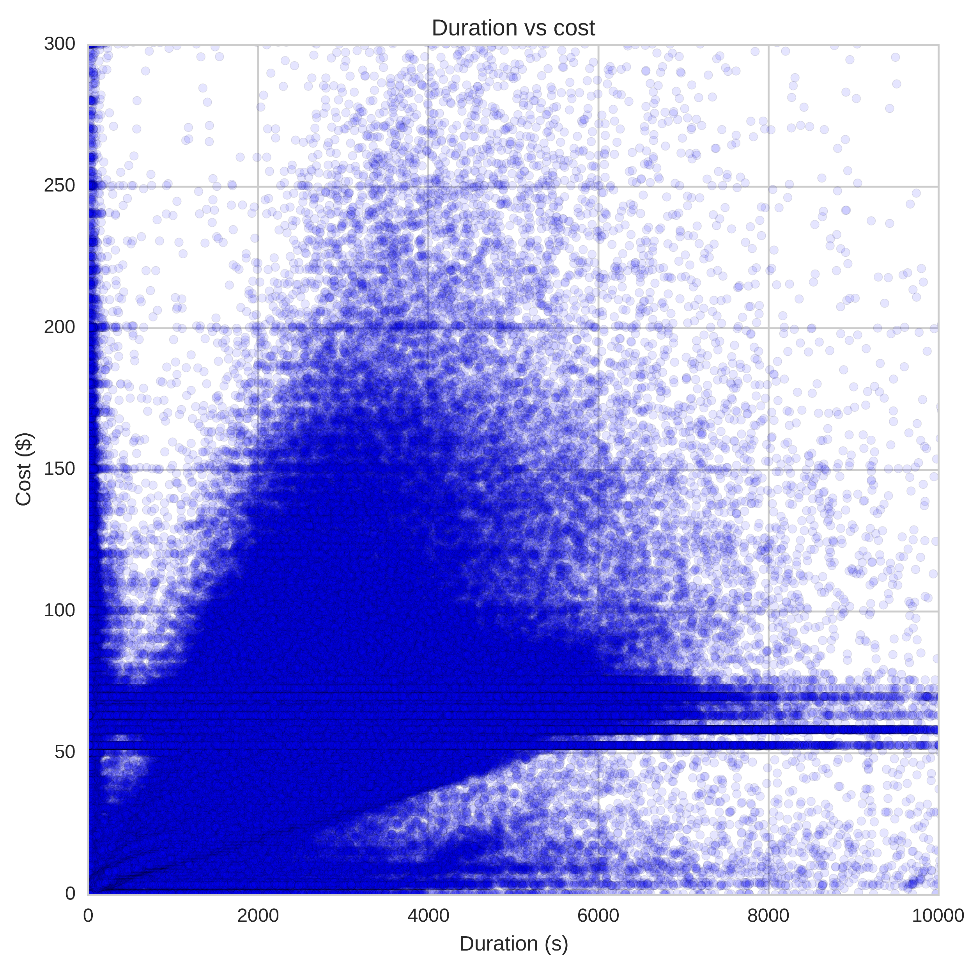
Exploratory analysis - 02
Cost vs Duration of ride
All 146 million rides : cost vs duration scatter plot
Expected somewhat linear relation
Interesting part :
Near constant cost lines around : $50, $60, $70 etc
Tips rounded off to nearest 5/10 , fixed rides, traffic(?)

Slide 7
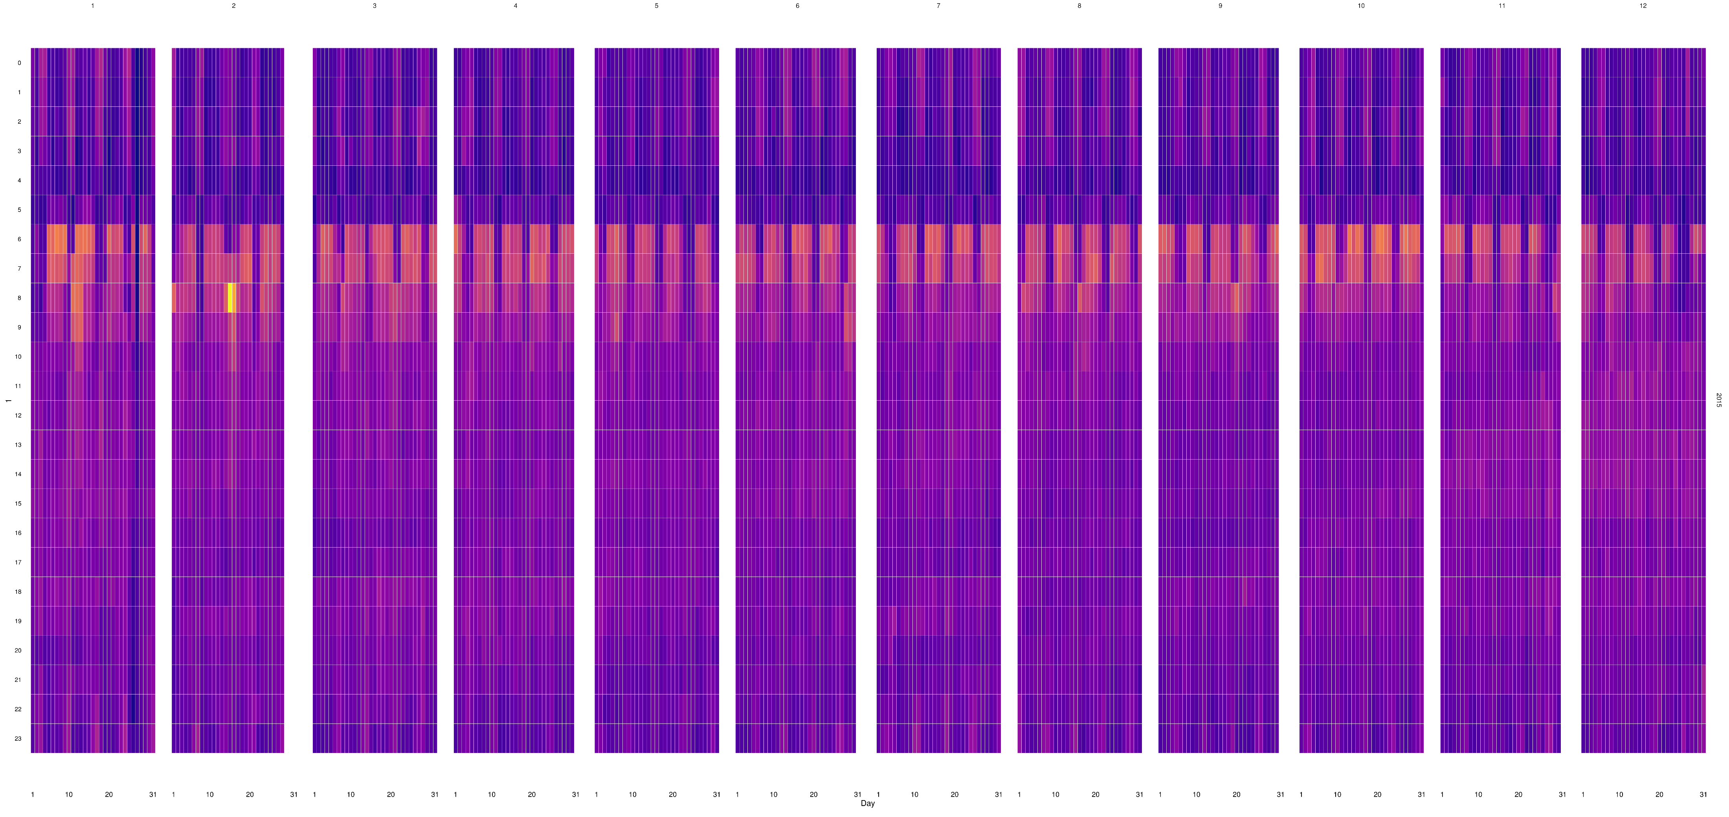
Exploratory analysis - 03
6-9 AM office
11PM to early morning over weekends
Brightest spot in the heat map

Slide 8
Graph : Properties
Degree distribution follows power law
Degree is highest for structural transportation centers:
Penn Station
Grand Central
PATH bus terminal
Notes:
Jiang

Slide 9
Similarities in These Routes
The most frequent taxi trips take place when:
There is no alternative transportation other than walking, e.g. the 3rd graph
Although subway or buses are available, it takes longer time to transfer between them to get to a desired location, e.g. from Grand Ctr to Penn Station
Most of these frequent trips have relatively short distance, meaning that there taxis are effectively filling the gap of mass public transit
Notes:
Jiang

Slide 10
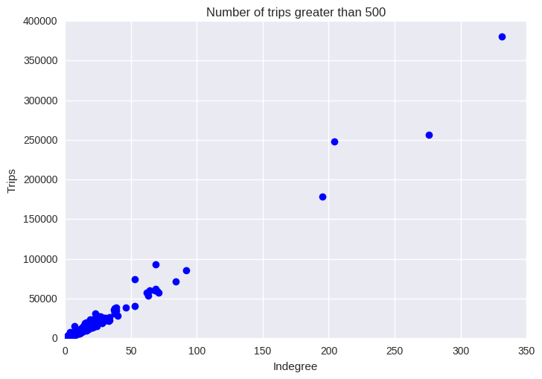
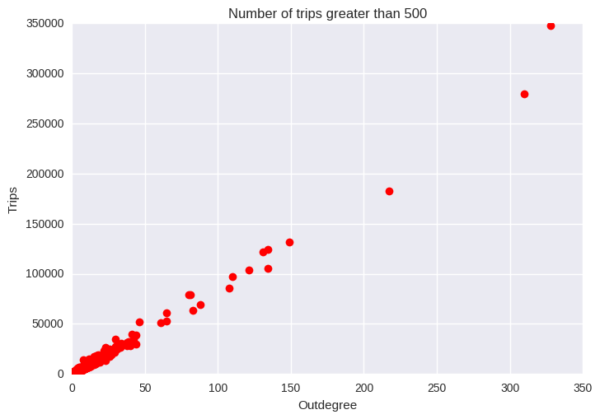
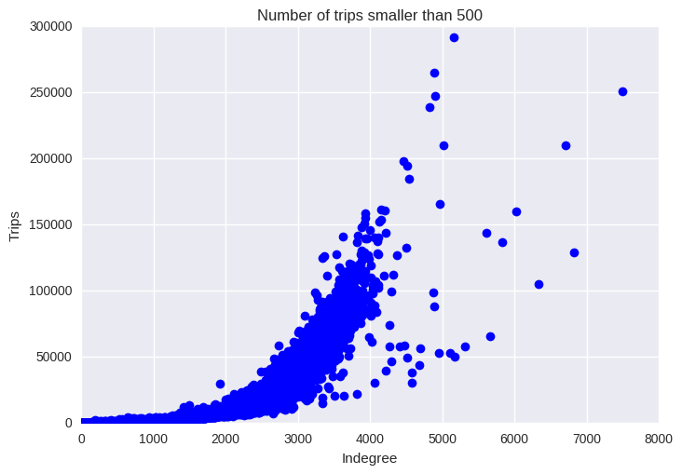
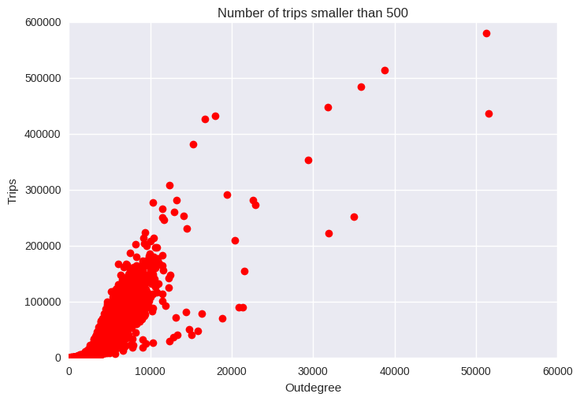
Trips Versus Degree Ratio
Notes:
Jiang

Slide 11
Trips Versus Degree Ratio
For number of trips>=500, most of the outliers being Madison Square Garden, Penn Station such inner city attractions. This means a large number of people coming to these places from relatively fixed places and most of these places are in Manhattan (e.g. 250,000 trips coming from about 200 places. On average 1250 trips from the same place)
For number of trips <500, most of the outliers being Airports, and the trips/degree ratio is much smaller, meaning small amount of people coming from all sorts of places. And we can easily identify places with low connectivity by looking at the ‘tail’ (the smaller the ratio is, the farther away it is from Manhattan)
Notes:
Jiang

Slide 12
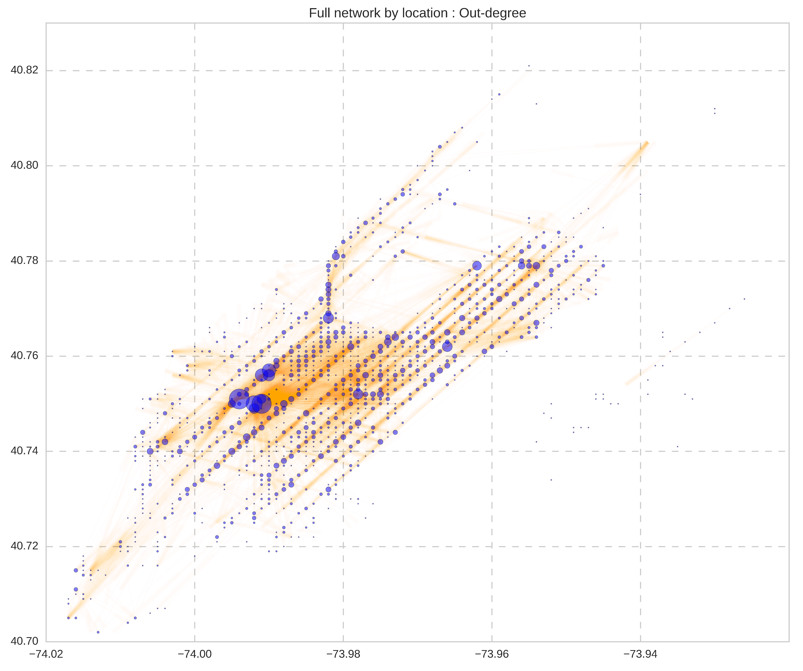
Broadway &7th Avenue : South bound
6th Avenue : North Bound

Slide 13
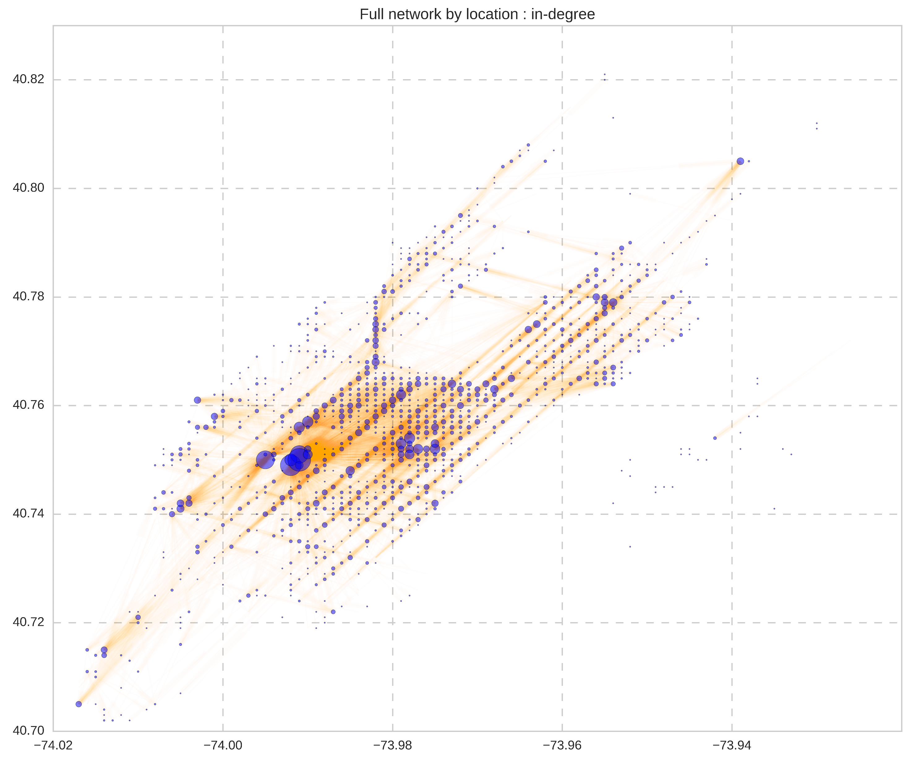

Slide 14
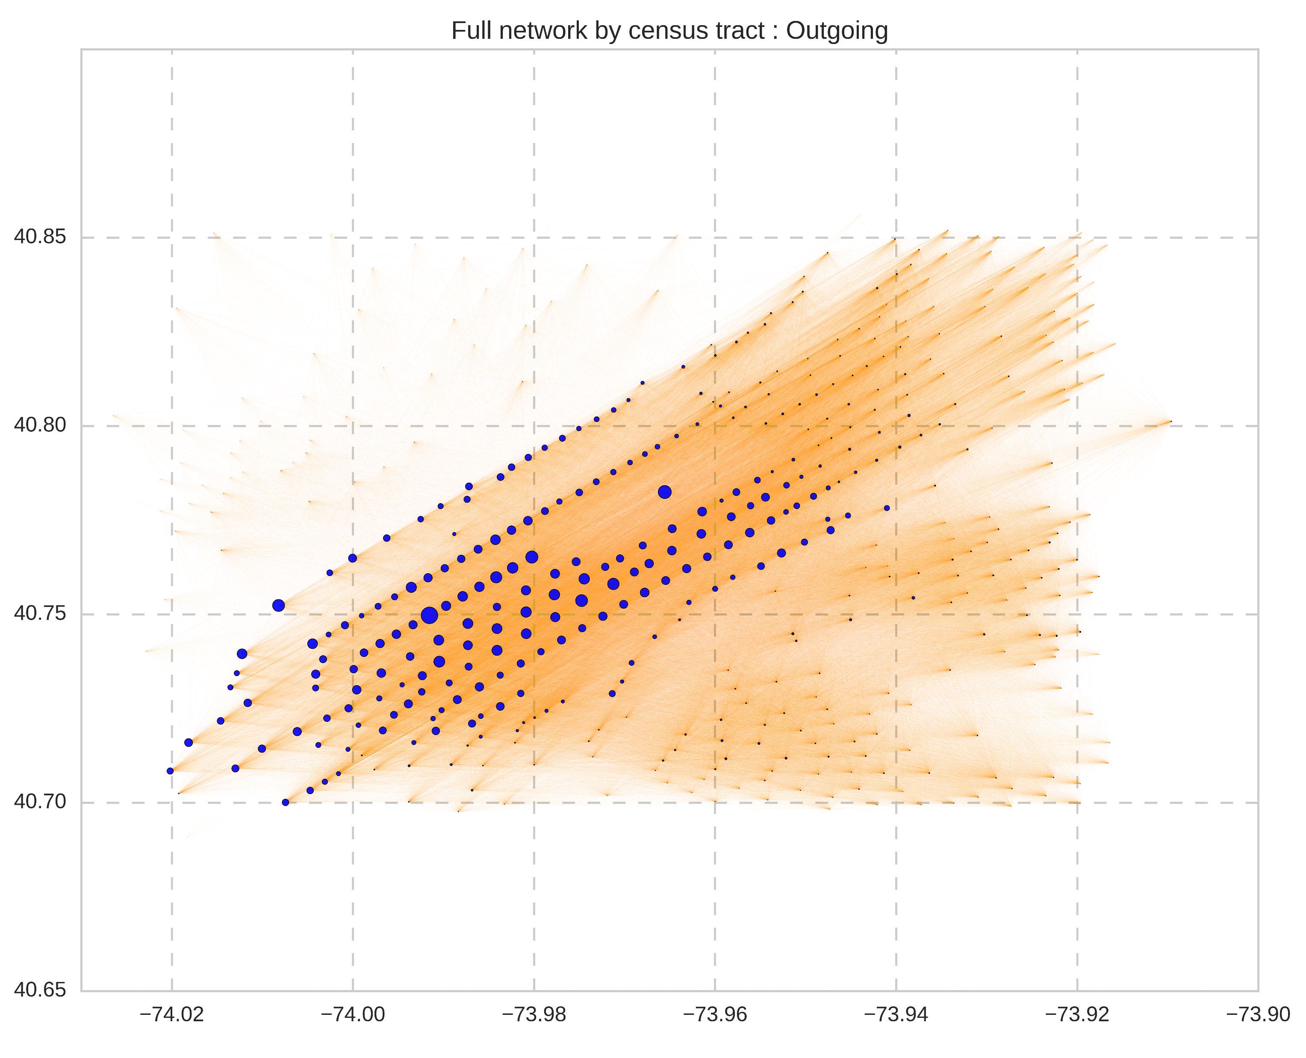

Slide 15
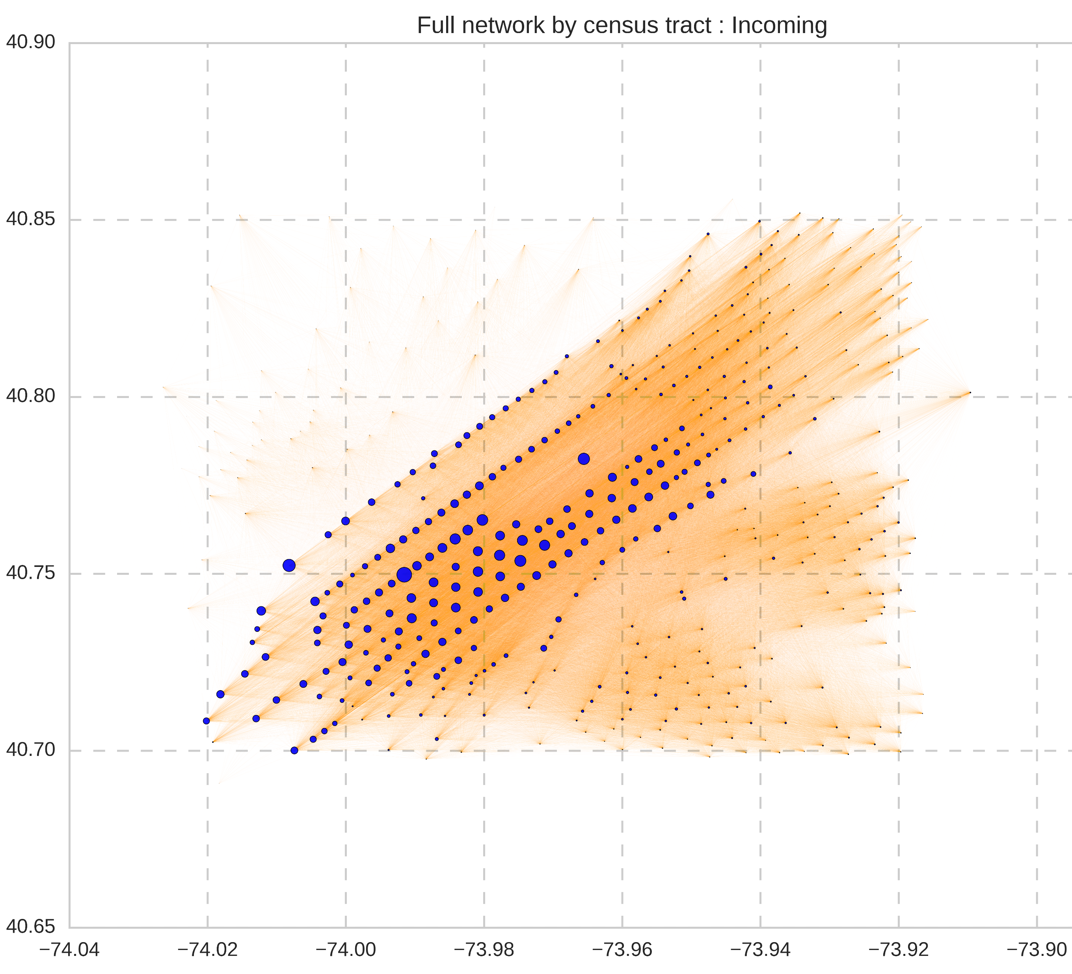

Slide 16
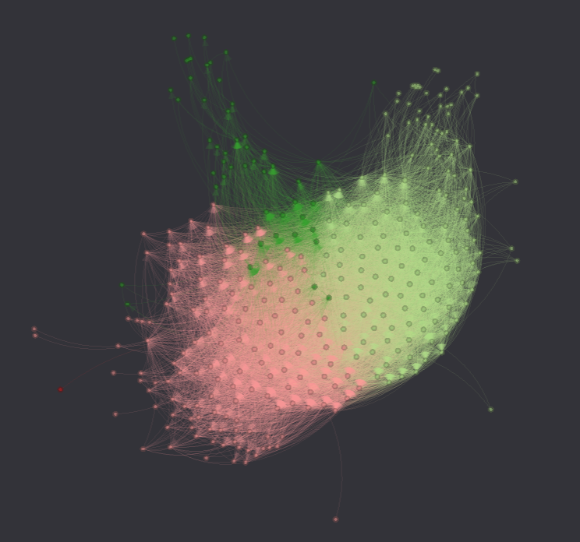
Community structure

Slide 17
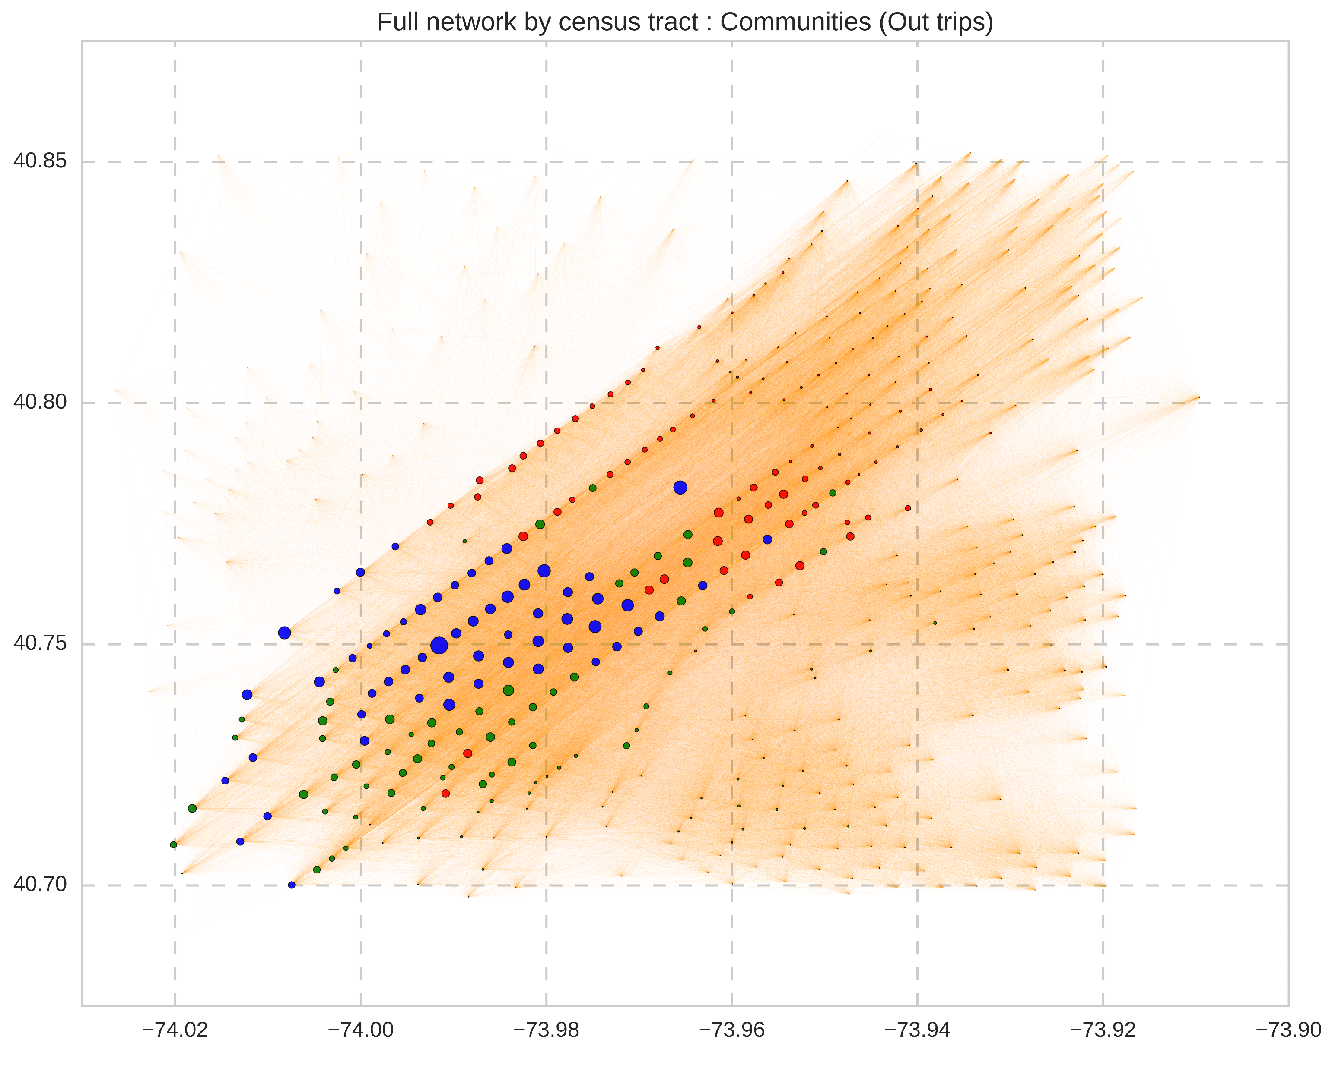

Slide 18
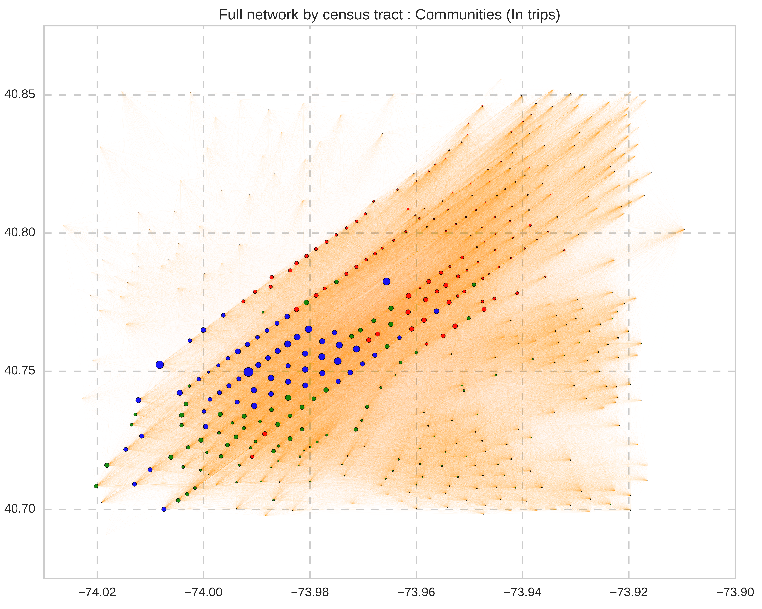

Slide 19
Conclusions
Apart from infrastructural transportation hubs, the only critical region seems to be around 5th & 6th avenue close to 50-55 streets ( our reasoning is that they correspond to office locations)
Taxi transportation in NYC has Broadway & 6th avenue as its central veins, any blockage on these 2 routes might lead to severe disruption ( as seen in the past few days since the President elect decided to work from his office in Trump Towers )
From the community structure that we got:
East village & Brooklyn seem to fall cleanly in a single community, due to restricted subway transportation towards North, in general
Bronx & Queens fall in a single cluster because of the same reason, but the connectivity is restricted towards each other
Manhattan falls into a single community due to extremely high connectivity within itself and relatively higher connections to other two communities
Further work:
Analyze communities in a more detailed way
Similar community analysis for all available years (2009-2015)
Changes across years

